Slide 1
Chapter 26
Capacitance and Dielectrics

Slide 2
Circuits and Circuit Elements
Electric circuits are the basis for the vast majority of the devices used in society.
Circuit elements can be connected with wires to form electric circuits.
Capacitors are one circuit element.
  Others will be introduced in other chapters
Introduction

Slide 3
Capacitors
Capacitors are devices that store electric charge.
Examples of where capacitors are used include:
  radio receivers
  filters in power supplies
  to eliminate sparking in automobile ignition systems
  energy-storing devices in electronic flashes
Introduction

Slide 4
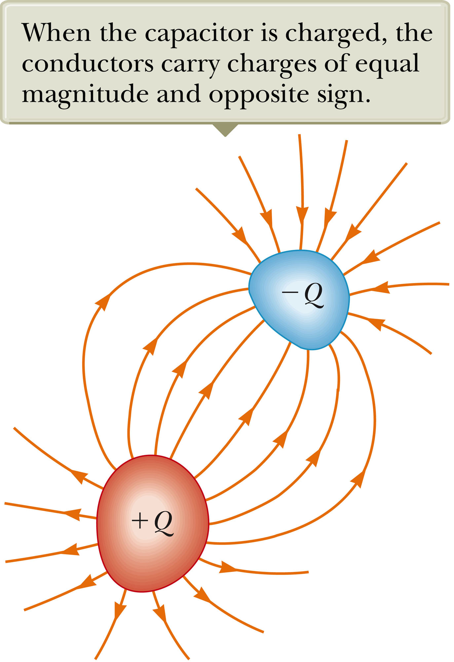
Makeup of a Capacitor
A capacitor consists of two conductors.
  These conductors are called plates.
  When the conductor is charged, the plates carry charges of equal magnitude and opposite directions.
A potential difference exists between the plates due to the charge.
Section 26.1

Slide 5
Definition of Capacitance
The capacitance, C, of a capacitor is defined as the ratio of the magnitude of the charge on either conductor to the potential difference between the conductors.
The SI unit of capacitance is the farad (F).
The farad is a large unit, typically you will see microfarads (mF) and picofarads (pF).
Capacitance will always be a positive quantity
The capacitance of a given capacitor is constant.
The capacitance is a measure of the capacitor’s ability to store charge .
  The capacitance of a capacitor is the amount of charge the capacitor can store per unit of potential difference.
Section 26.1

Slide 6
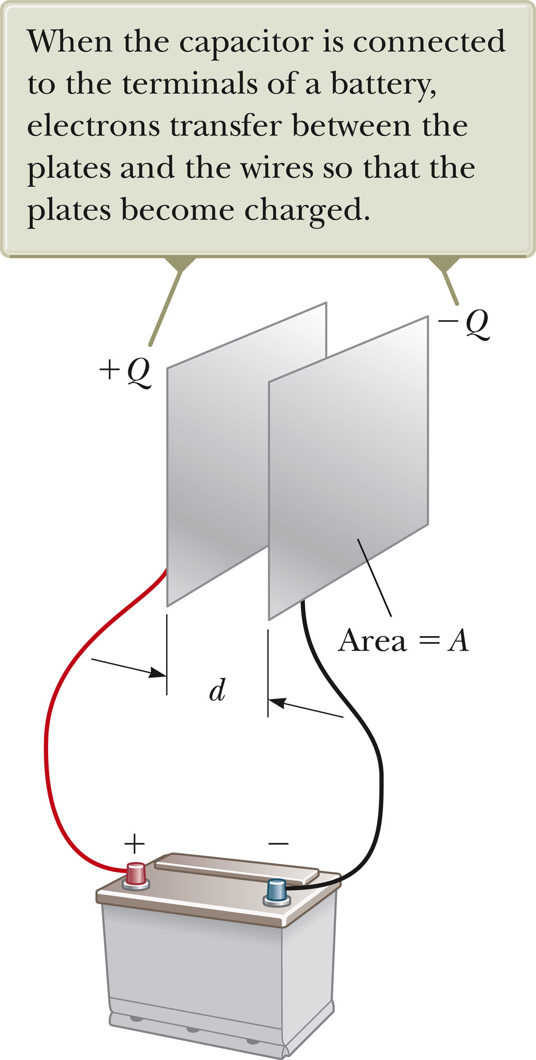
Parallel Plate Capacitor
Each plate is connected to a terminal of the battery.
  The battery is a source of potential difference.
If the capacitor is initially uncharged, the battery establishes an electric field in the connecting wires.
Section 26.1

Slide 7
Parallel Plate Capacitor, cont
This field applies a force on electrons in the wire just outside of the plates.
The force causes the electrons to move onto the negative plate.
This continues until equilibrium is achieved.
  The plate, the wire and the terminal are all at the same potential.
At this point, there is no field present in the wire and the movement of the electrons ceases.
The plate is now negatively charged.
A similar process occurs at the other plate, electrons moving away from the plate and leaving it positively charged.
In its final configuration, the potential difference across the capacitor plates is the same as that between the terminals of the battery.
Section 26.1

Slide 8
Capacitance – Isolated Sphere
Assume a spherical charged conductor with radius a.
The sphere will have the same capacitance as it would if there were a conducting sphere of infinite radius, concentric with the original sphere.
Assume V = 0 for the infinitely large shell
Note, this is independent of the charge on the sphere and its potential.
Section 26.2

Slide 9
Capacitance – Parallel Plates
The charge density on the plates is σ = Q/A.
  A is the area of each plate, the area of each plate is equal
  Q is the charge on each plate, equal with opposite signs
The electric field is uniform between the plates and zero elsewhere.
The capacitance is proportional to the area of its plates and inversely proportional to the distance between the plates.
Section 26.2

Slide 10
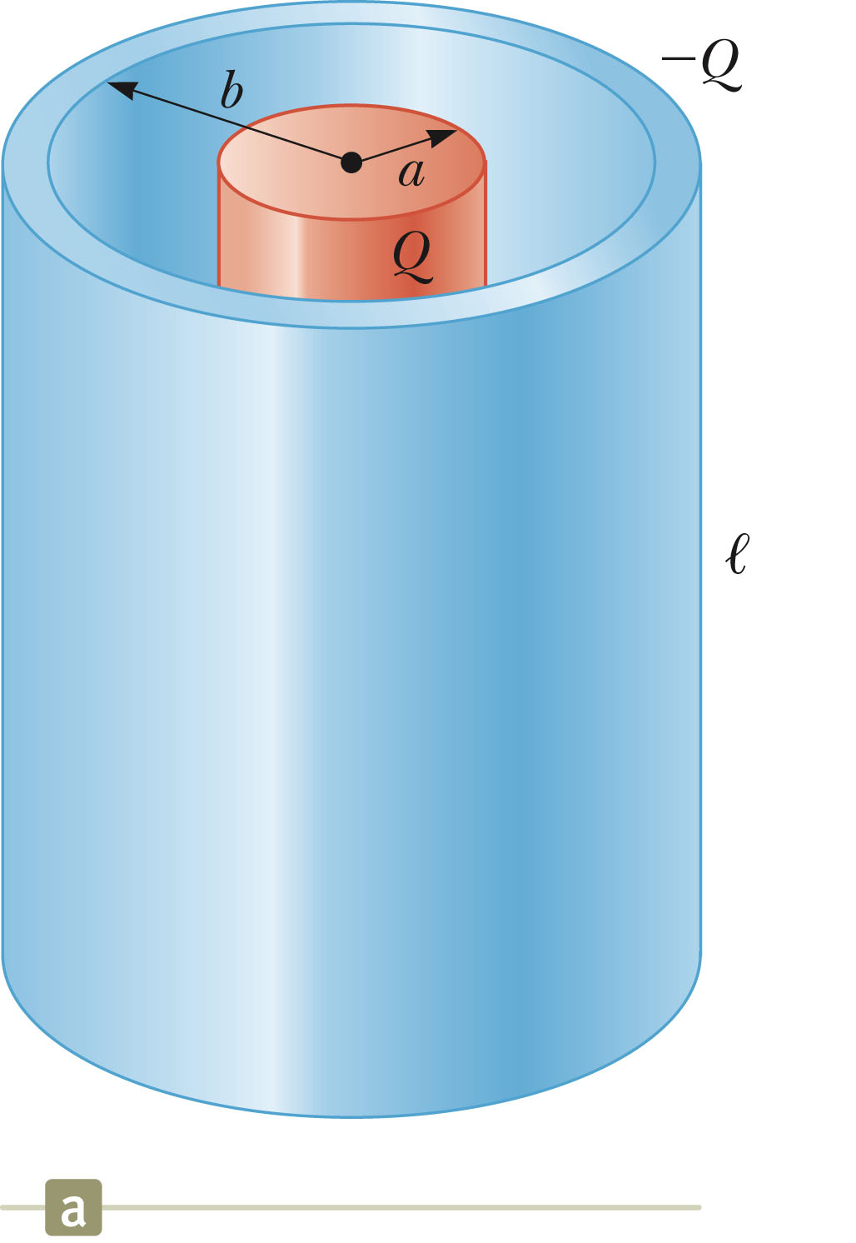
Capacitance of a Cylindrical Capacitor
ΔV = -2k_{e}λln (b/a)
λ = Q/l
The capacitance is
Section 26.2

Slide 11
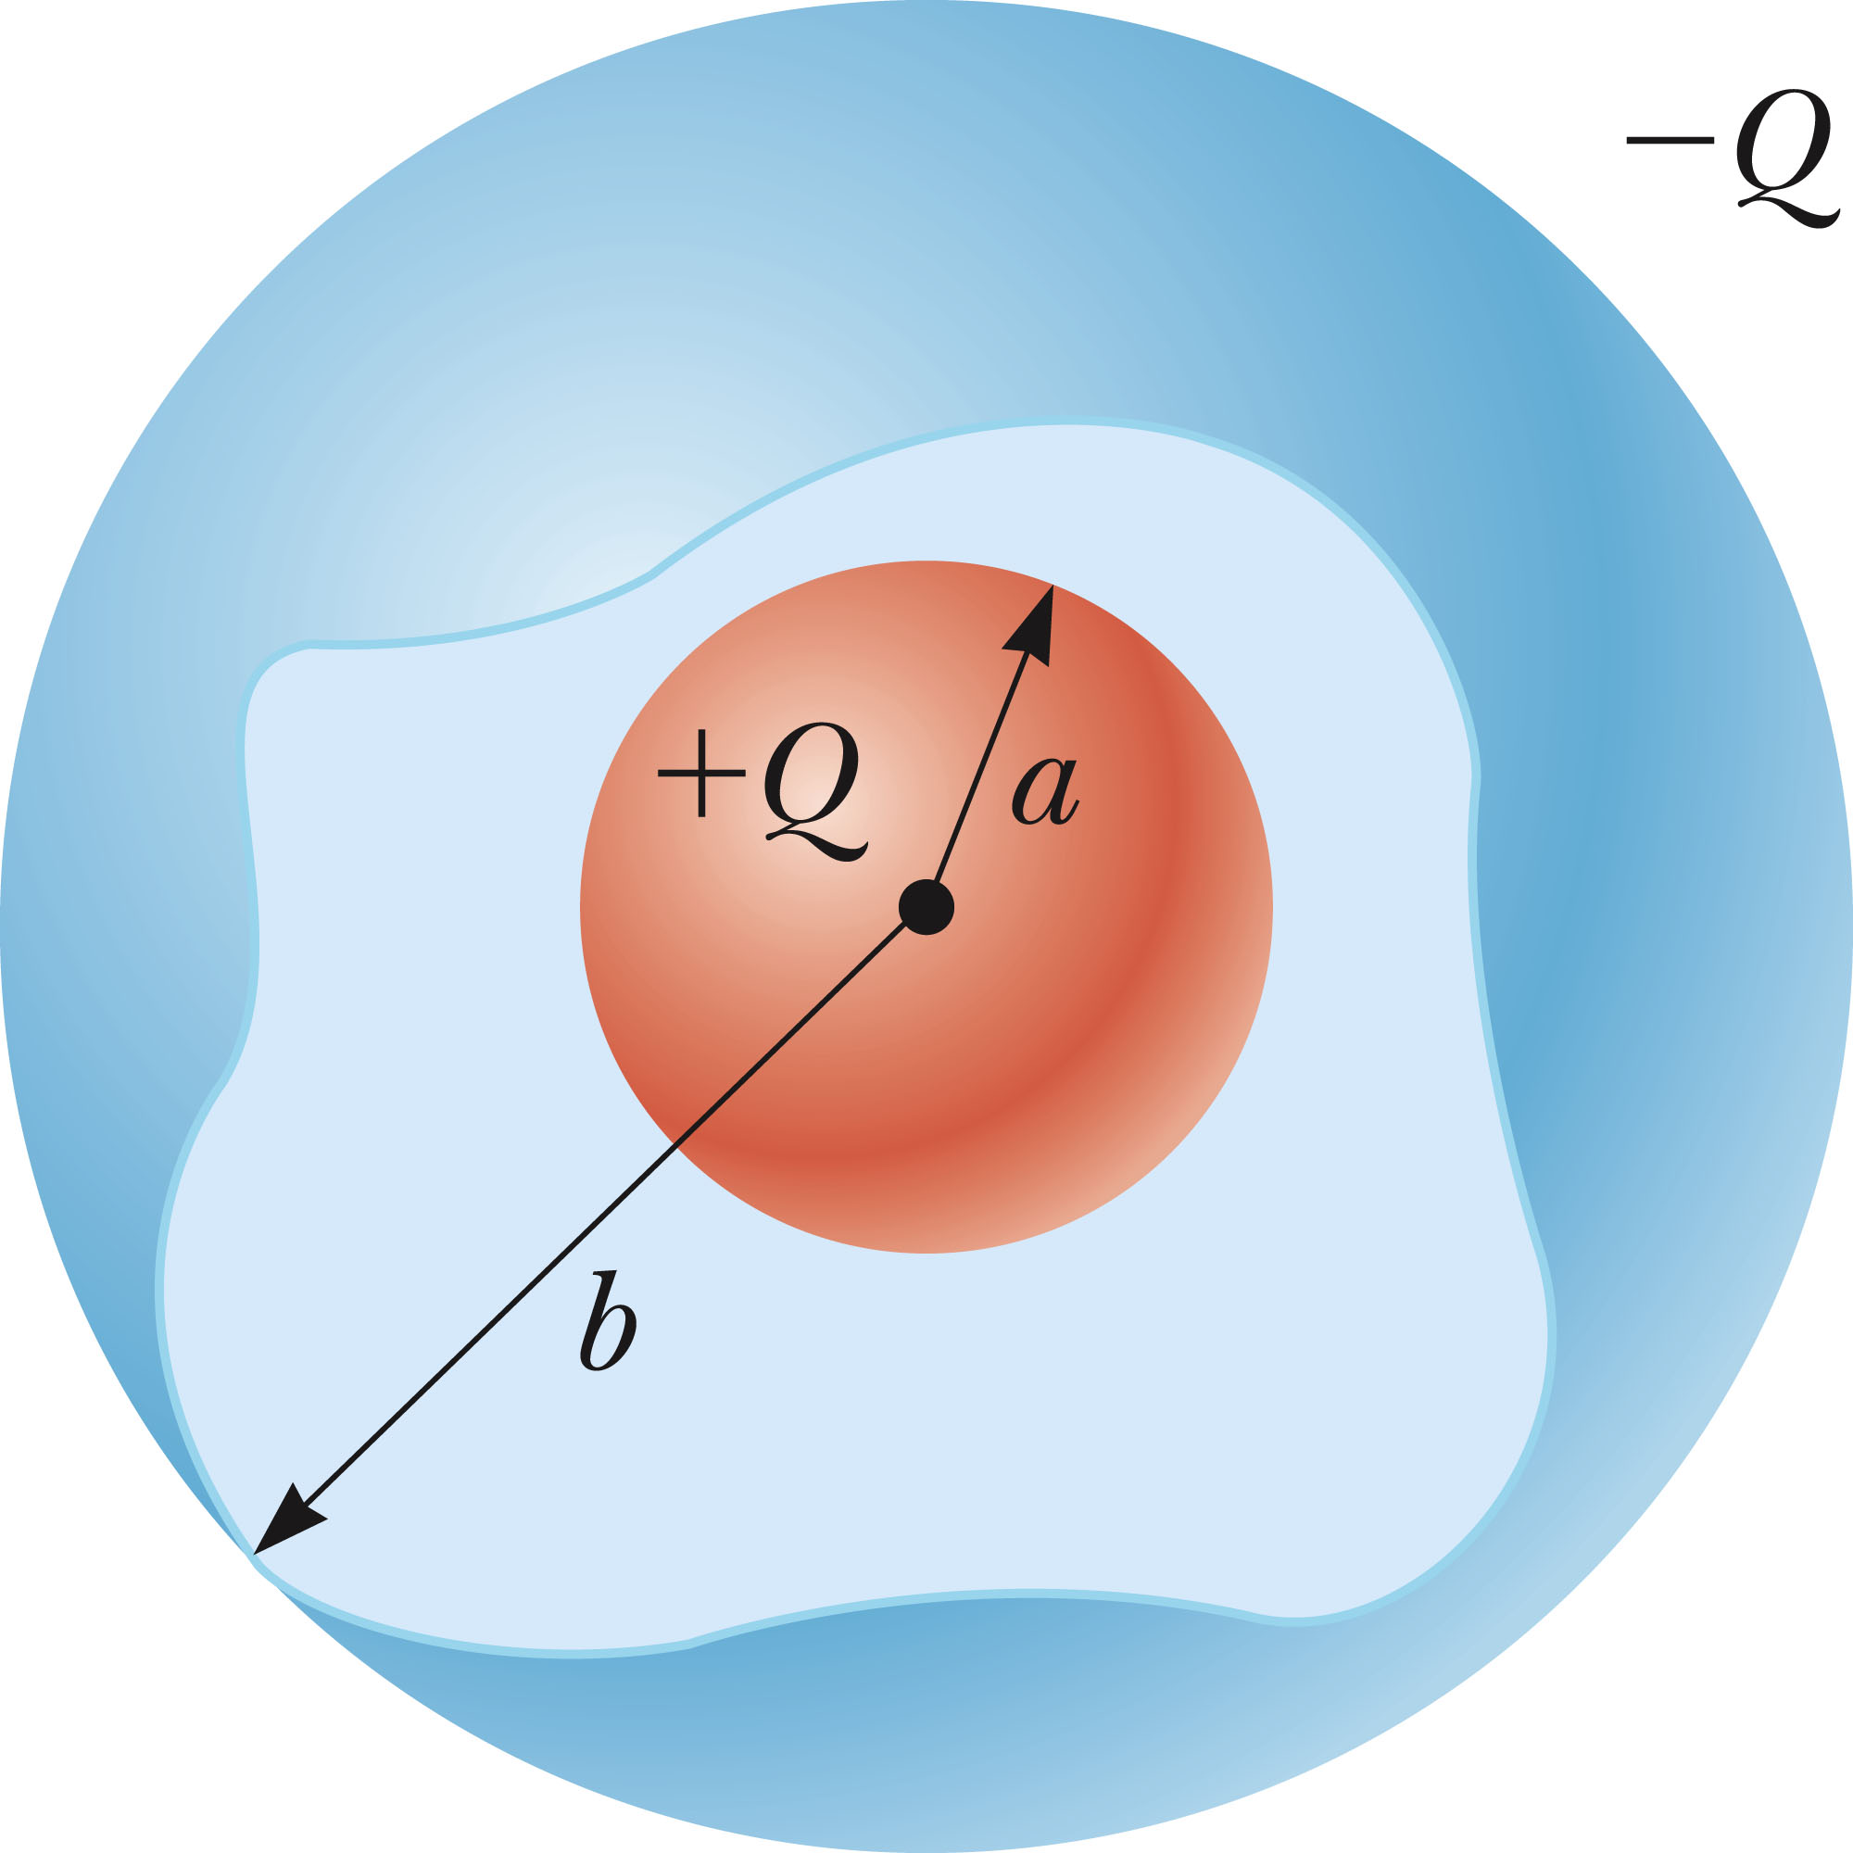
Capacitance of a Spherical Capacitor
The potential difference will be
The capacitance will be
Section 26.2

Slide 12
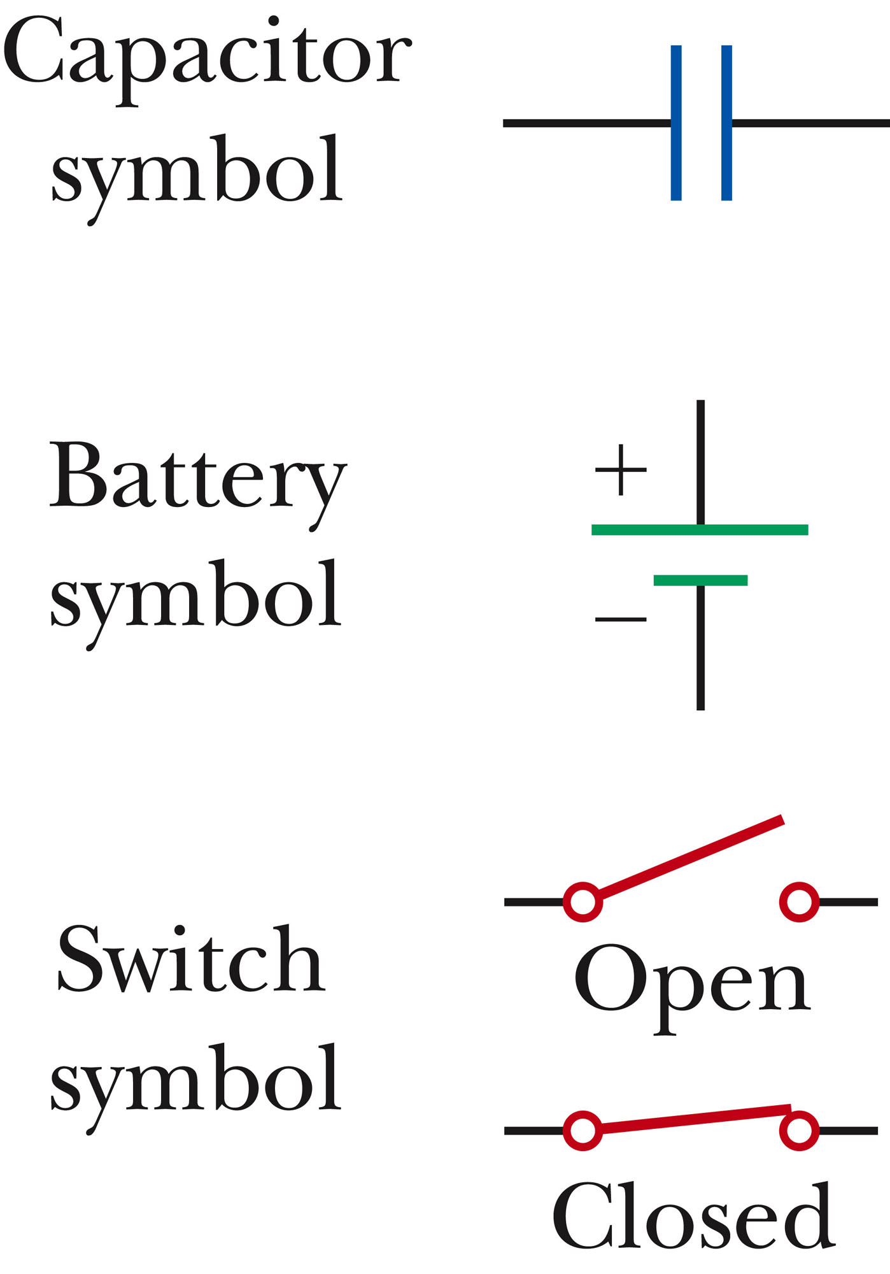
Circuit Symbols
A circuit diagram is a simplified representation of an actual circuit.
Circuit symbols are used to represent the various elements.
Lines are used to represent wires.
The battery’s positive terminal is indicated by the longer line.
Section 26.3

Slide 13
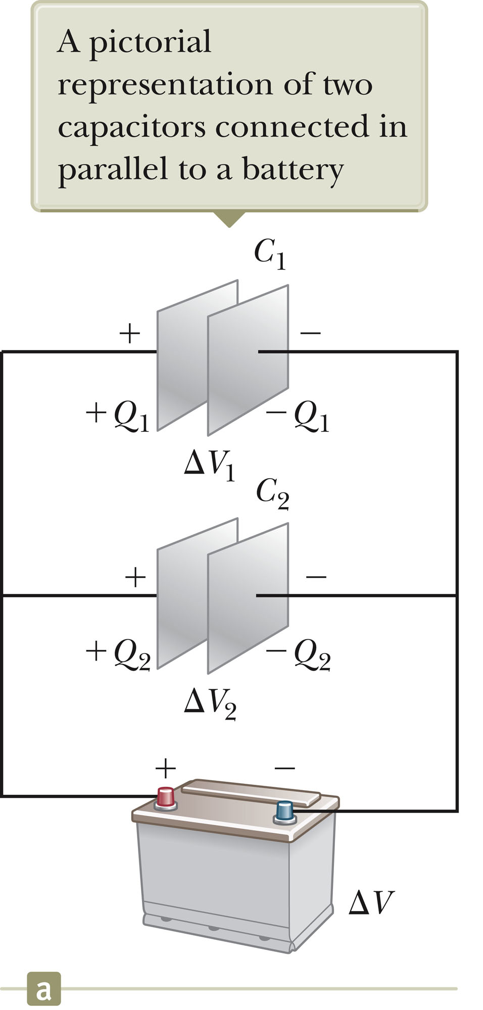
Capacitors in Parallel
When capacitors are first connected in the circuit, electrons are transferred from the left plates through the battery to the right plate, leaving the left plate positively charged and the right plate negatively charged.
Section 26.3

Slide 14
Capacitors in Parallel, 2
The flow of charges ceases when the voltage across the capacitors equals that of the battery.
The potential difference across the capacitors is the same.
  And each is equal to the voltage of the battery
  ΔV₁ = ΔV₂ = ΔV
    ΔV is the battery terminal voltage
The capacitors reach their maximum charge when the flow of charge ceases.
The total charge is equal to the sum of the charges on the capacitors.
  Q_{tot} = Q₁ + Q₂
Section 26.3

Slide 15
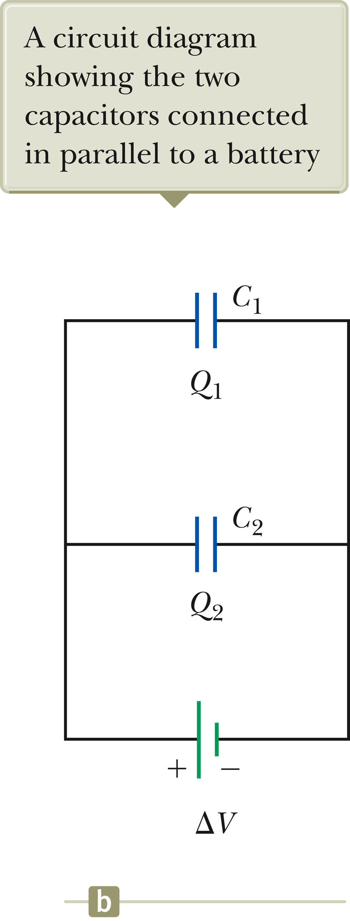
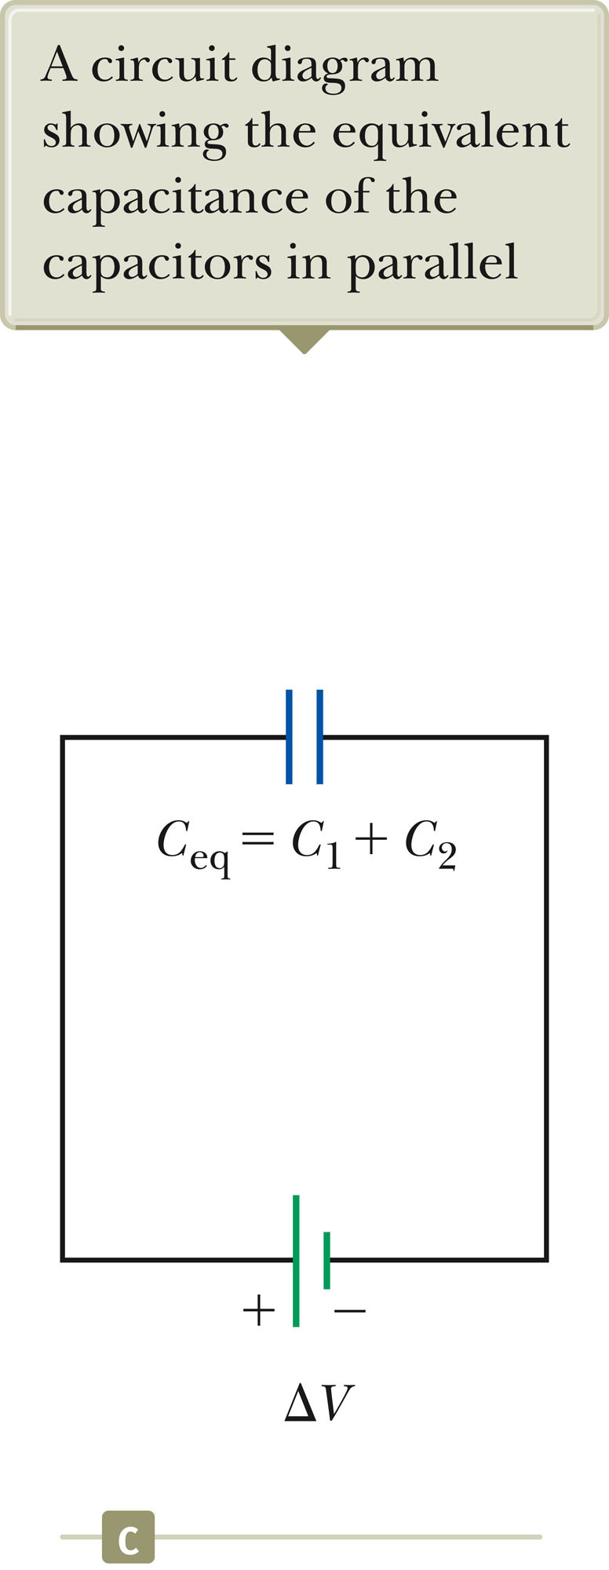
Capacitors in Parallel, 3
The capacitors can be replaced with one capacitor with a capacitance of C_{eq.}
  The equivalent capacitor must have exactly the same external effect on the circuit as the original capacitors.
Section 26.3

Slide 16
Capacitors in Parallel, final
C_{eq} = C₁ + C₂ + C₃ + …
The equivalent capacitance of a parallel combination of capacitors is greater than any of the individual capacitors.
  Essentially, the areas are combined
Section 26.3

Slide 17
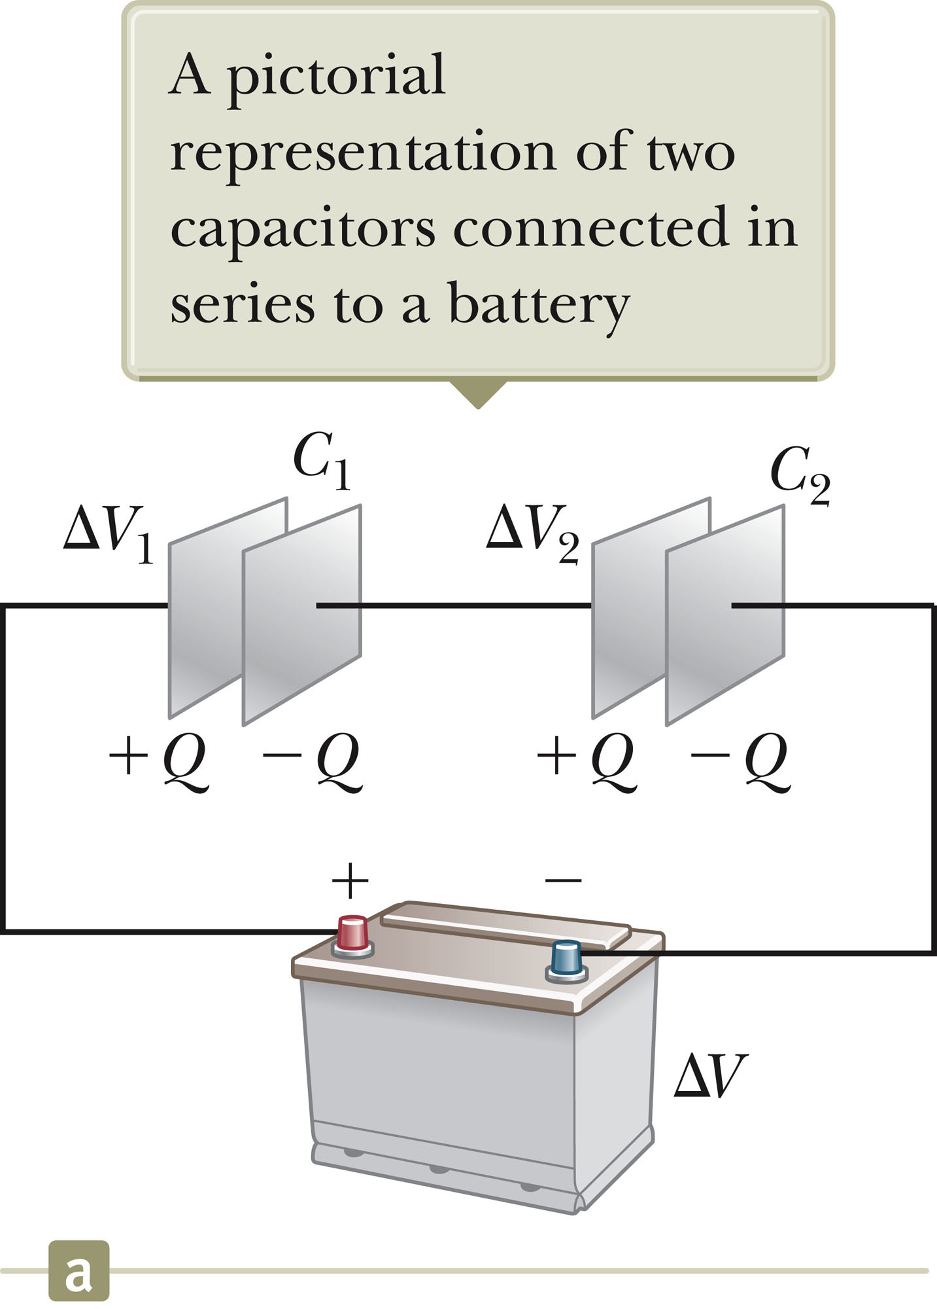
Capacitors in Series
When a battery is connected to the circuit, electrons are transferred from the left plate of C₁ to the right plate of C₂ through the battery.
As this negative charge accumulates on the right plate of C₂, an equivalent amount of negative charge is removed from the left plate of C₂, leaving it with an excess positive charge.
All of the right plates gain charges of –Q and all the left plates have charges of +Q.
Section 26.3

Slide 18
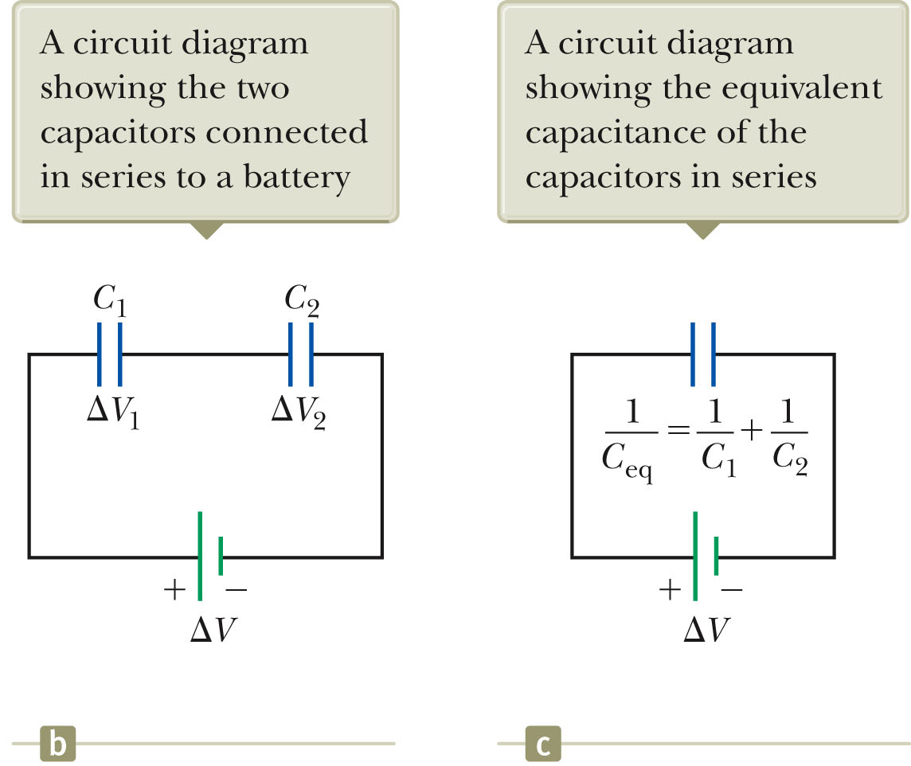
Capacitors in Series, cont.
An equivalent capacitor can be found that performs the same function as the series combination.
The charges are all the same.
Q₁ = Q₂ = Q
Section 26.3

Slide 19
Capacitors in Series, final
The potential differences add up to the battery voltage.
ΔV_{tot} = ΔV₁ + ΔV₂ + …
The equivalent capacitance is
The equivalent capacitance of a series combination is always less than any individual capacitor in the combination.
Section 26.3

Slide 20
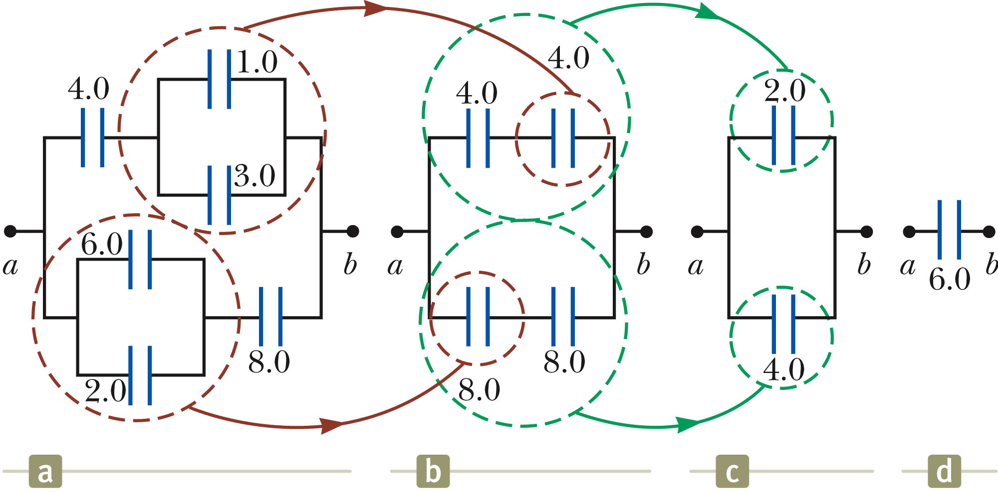
Equivalent Capacitance, Example
The 1.0-μF and 3.0-μF capacitors are in parallel as are the 6.0-μF and 2.0-μF capacitors.
These parallel combinations are in series with the capacitors next to them.
The series combinations are in parallel and the final equivalent capacitance can be found.
Section 26.3

Slide 21
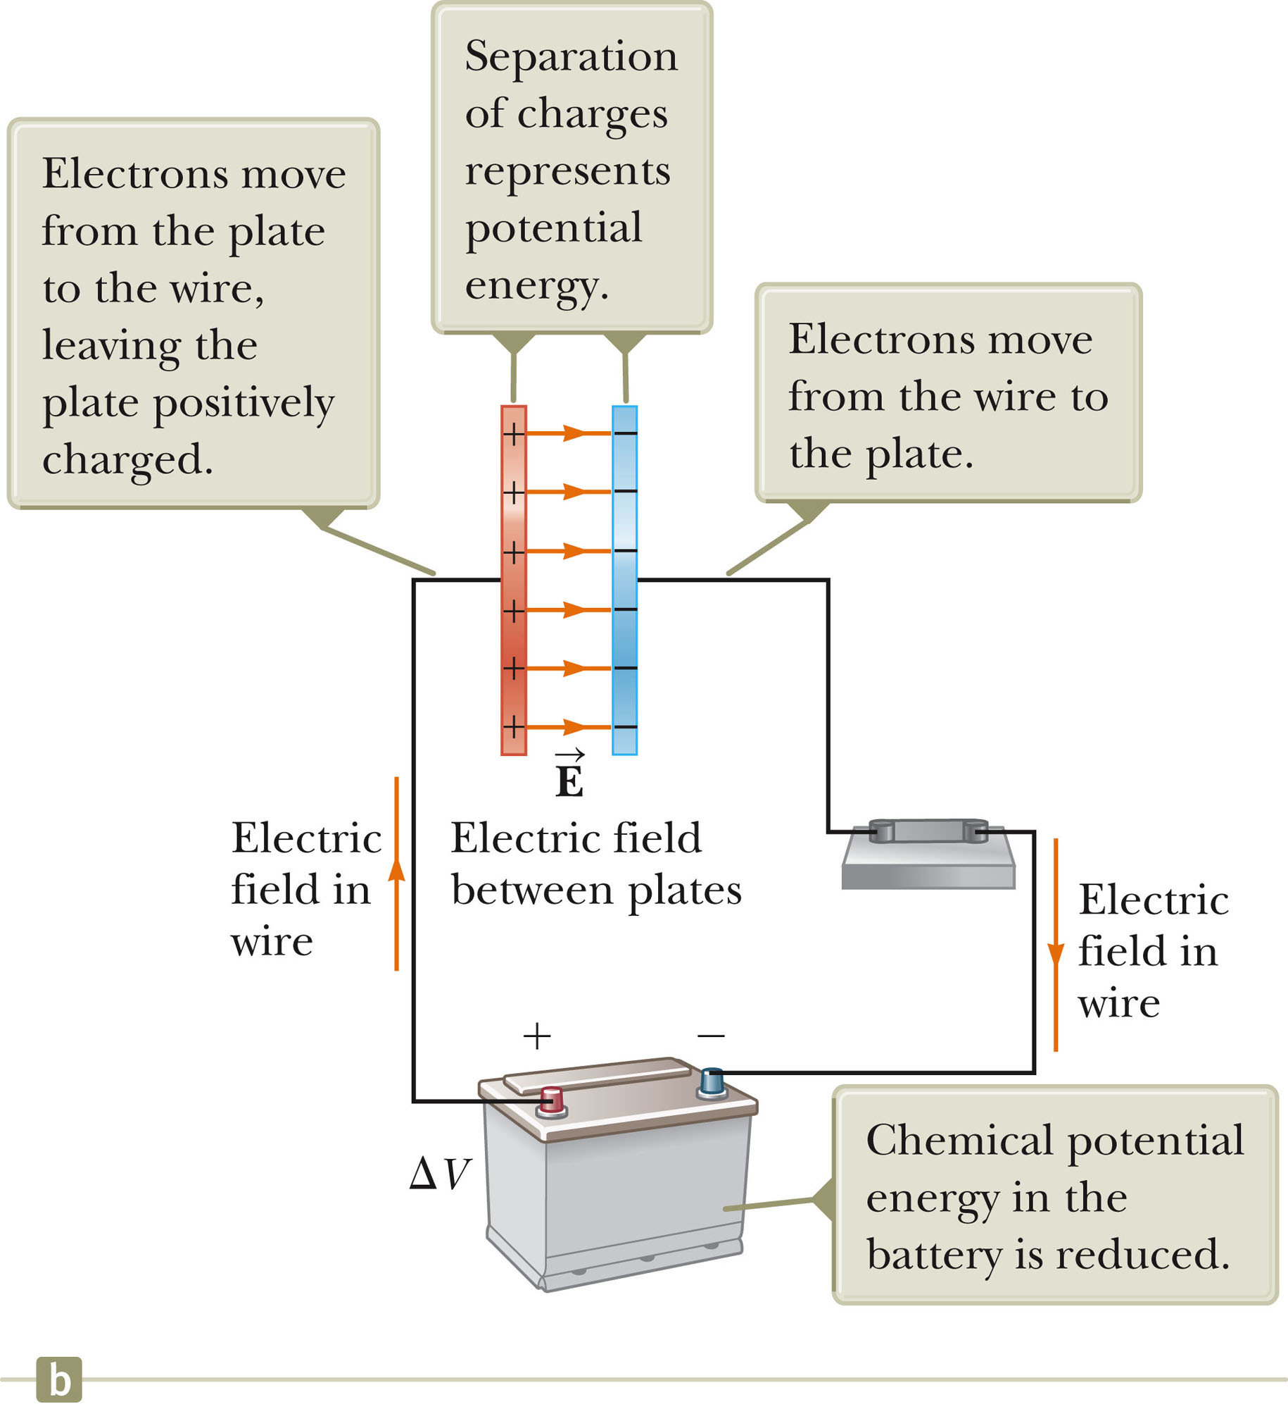
Energy in a Capacitor – Overview
Consider the circuit to be a system.
Before the switch is closed, the energy is stored as chemical energy in the battery.
When the switch is closed, the energy is transformed from chemical potential energy to electric potential energy.
The electric potential energy is related to the separation of the positive and negative charges on the plates.
A capacitor can be described as a device that stores energy as well as charge.
Section 26.4

Slide 22
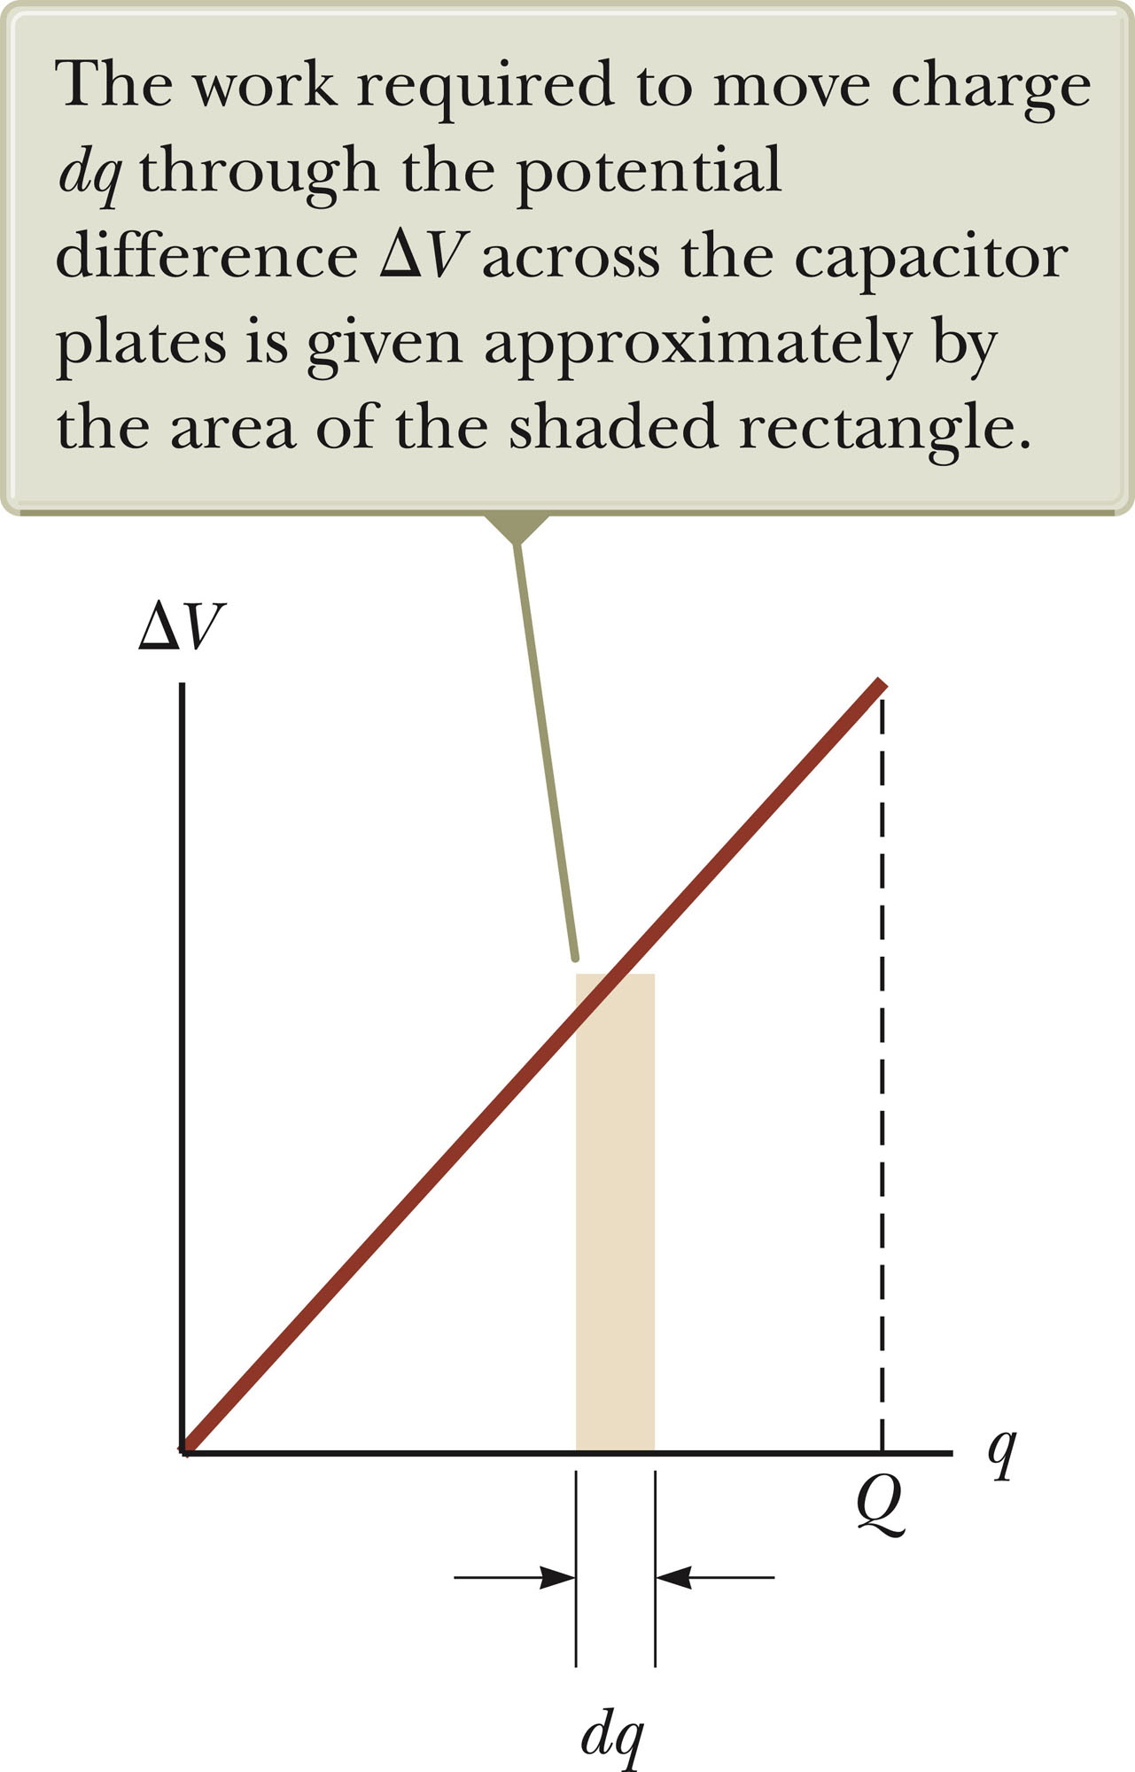
Energy Stored in a Capacitor
Assume the capacitor is being charged and, at some point, has a charge q on it.
The work needed to transfer a charge from one plate to the other is
The work required is the area of the tan rectangle.
The total work required is
Section 26.4

Slide 23
Energy, cont
The work done in charging the capacitor appears as electric potential energy U:
This applies to a capacitor of any geometry.
The energy stored increases as the charge increases and as the potential difference increases.
In practice, there is a maximum voltage before discharge occurs between the plates.
Section 26.4

Slide 24
Energy, final
The energy can be considered to be stored in the electric field .
For a parallel-plate capacitor, the energy can be expressed in terms of the field as U = ½ (ε_{o}Ad)E².
It can also be expressed in terms of the energy density (energy per unit volume)
u_{E} = ½ ε_{o}E².
Section 26.4

Slide 25
Some Uses of Capacitors
Defibrillators
  When cardiac fibrillation occurs, the heart produces a rapid, irregular pattern of beats
  A fast discharge of electrical energy through the heart can return the organ to its normal beat pattern.
In general, capacitors act as energy reservoirs that can be slowly charged and then discharged quickly to provide large amounts of energy in a short pulse.
Section 26.4

Slide 26
Capacitors with Dielectrics
A dielectric is a nonconducting material that, when placed between the plates of a capacitor, increases the capacitance.
  Dielectrics include rubber, glass, and waxed paper
With a dielectric, the capacitance becomes C = κC_{o.}
  The capacitance increases by the factor κ when the dielectric completely fills the region between the plates.
  κ is the dielectric constant of the material.
If the capacitor remains connected to a battery, the voltage across the capacitor necessarily remains the same.
If the capacitor is disconnected from the battery, the capacitor is an isolated system and the charge remains the same.
Section 26.5

Slide 27
Dielectrics, cont
For a parallel-plate capacitor, C = κ (ε_{o}A) / d
In theory, d could be made very small to create a very large capacitance.
In practice, there is a limit to d.
  d is limited by the electric discharge that could occur though the dielectric medium separating the plates.
For a given d, the maximum voltage that can be applied to a capacitor without causing a discharge depends on the dielectric strength of the material.
Section 26.5

Slide 28
Dielectrics, final
Dielectrics provide the following advantages:
  Increase in capacitance
  Increase the maximum operating voltage
  Possible mechanical support between the plates
    This allows the plates to be close together without touching.
    This decreases d and increases C.
Section 26.5

Slide 29
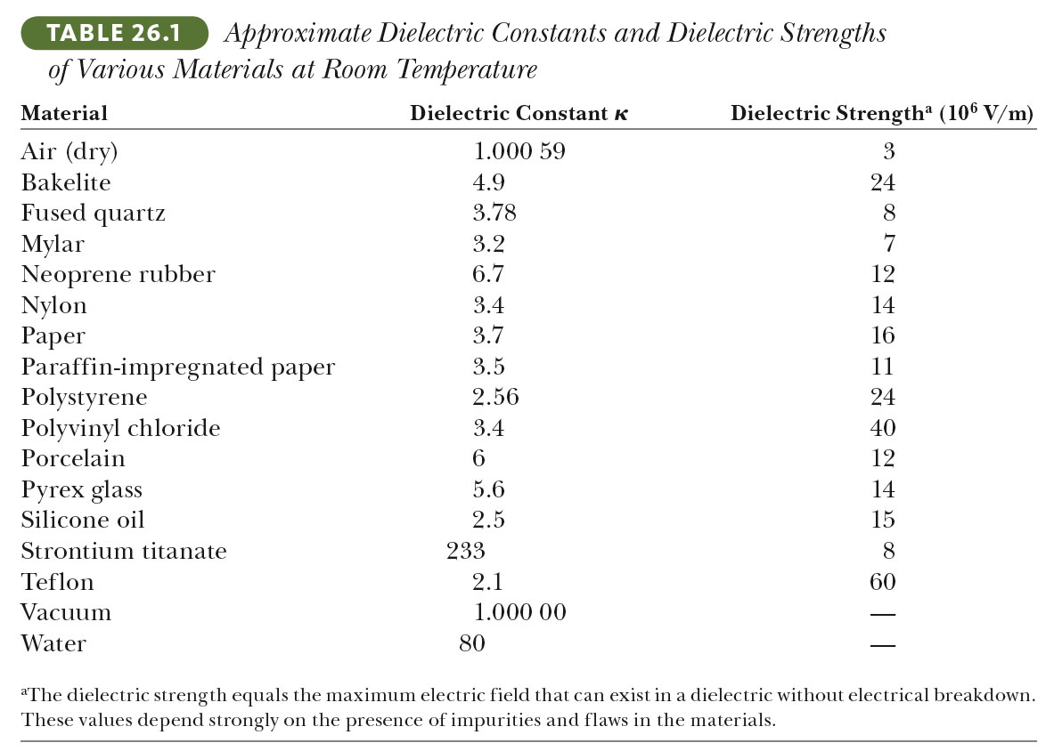
Some Dielectric Constants and Dielectric Strengths
Section 26.5

Slide 30
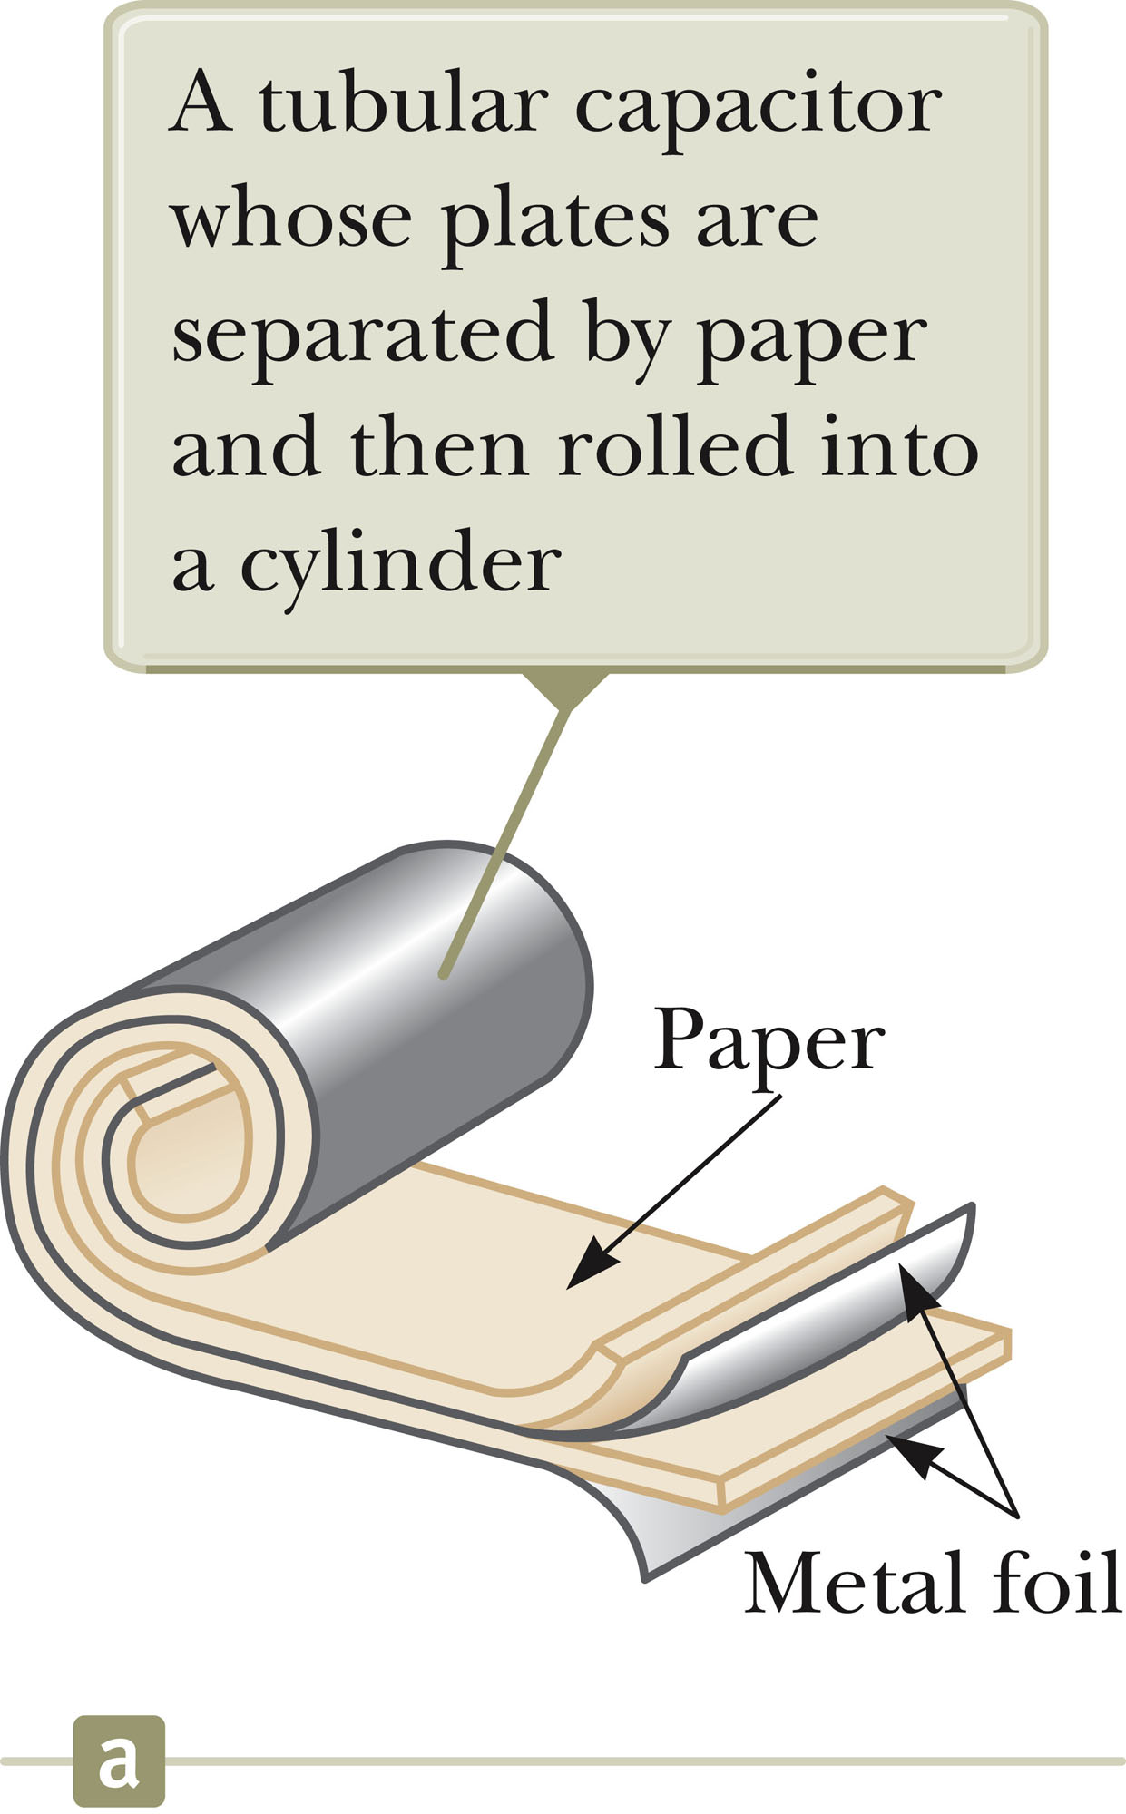
Types of Capacitors – Tubular
Metallic foil may be interlaced with thin sheets of paraffin-impregnated paper or Mylar.
The layers are rolled into a cylinder to form a small package for the capacitor.
Section 26.5

Slide 31
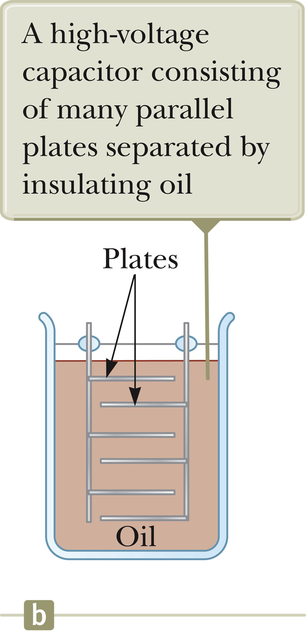
Types of Capacitors – Oil Filled
Common for high-voltage capacitors
A number of interwoven metallic plates are immersed in silicon oil.
Section 26.5

Slide 32
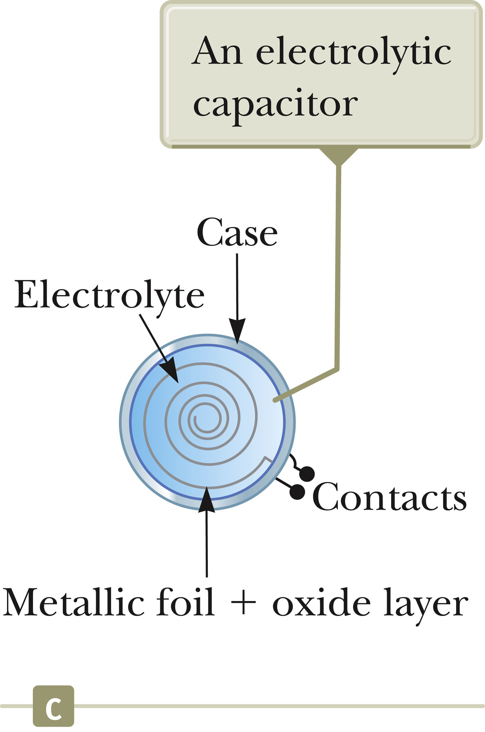
Types of Capacitors – Electrolytic
Used to store large amounts of charge at relatively low voltages
The electrolyte is a solution that conducts electricity by virtue of motion of ions contained in the solution.
When a voltage is applied between the foil and the electrolyte, a thin layer of metal oxide is formed on the foil.
This layer serves as a dielectric.
Large values of capacitance can be obtained because the dielectric layer is very thin and the plate separation is very small.
Section 26.5

Slide 33
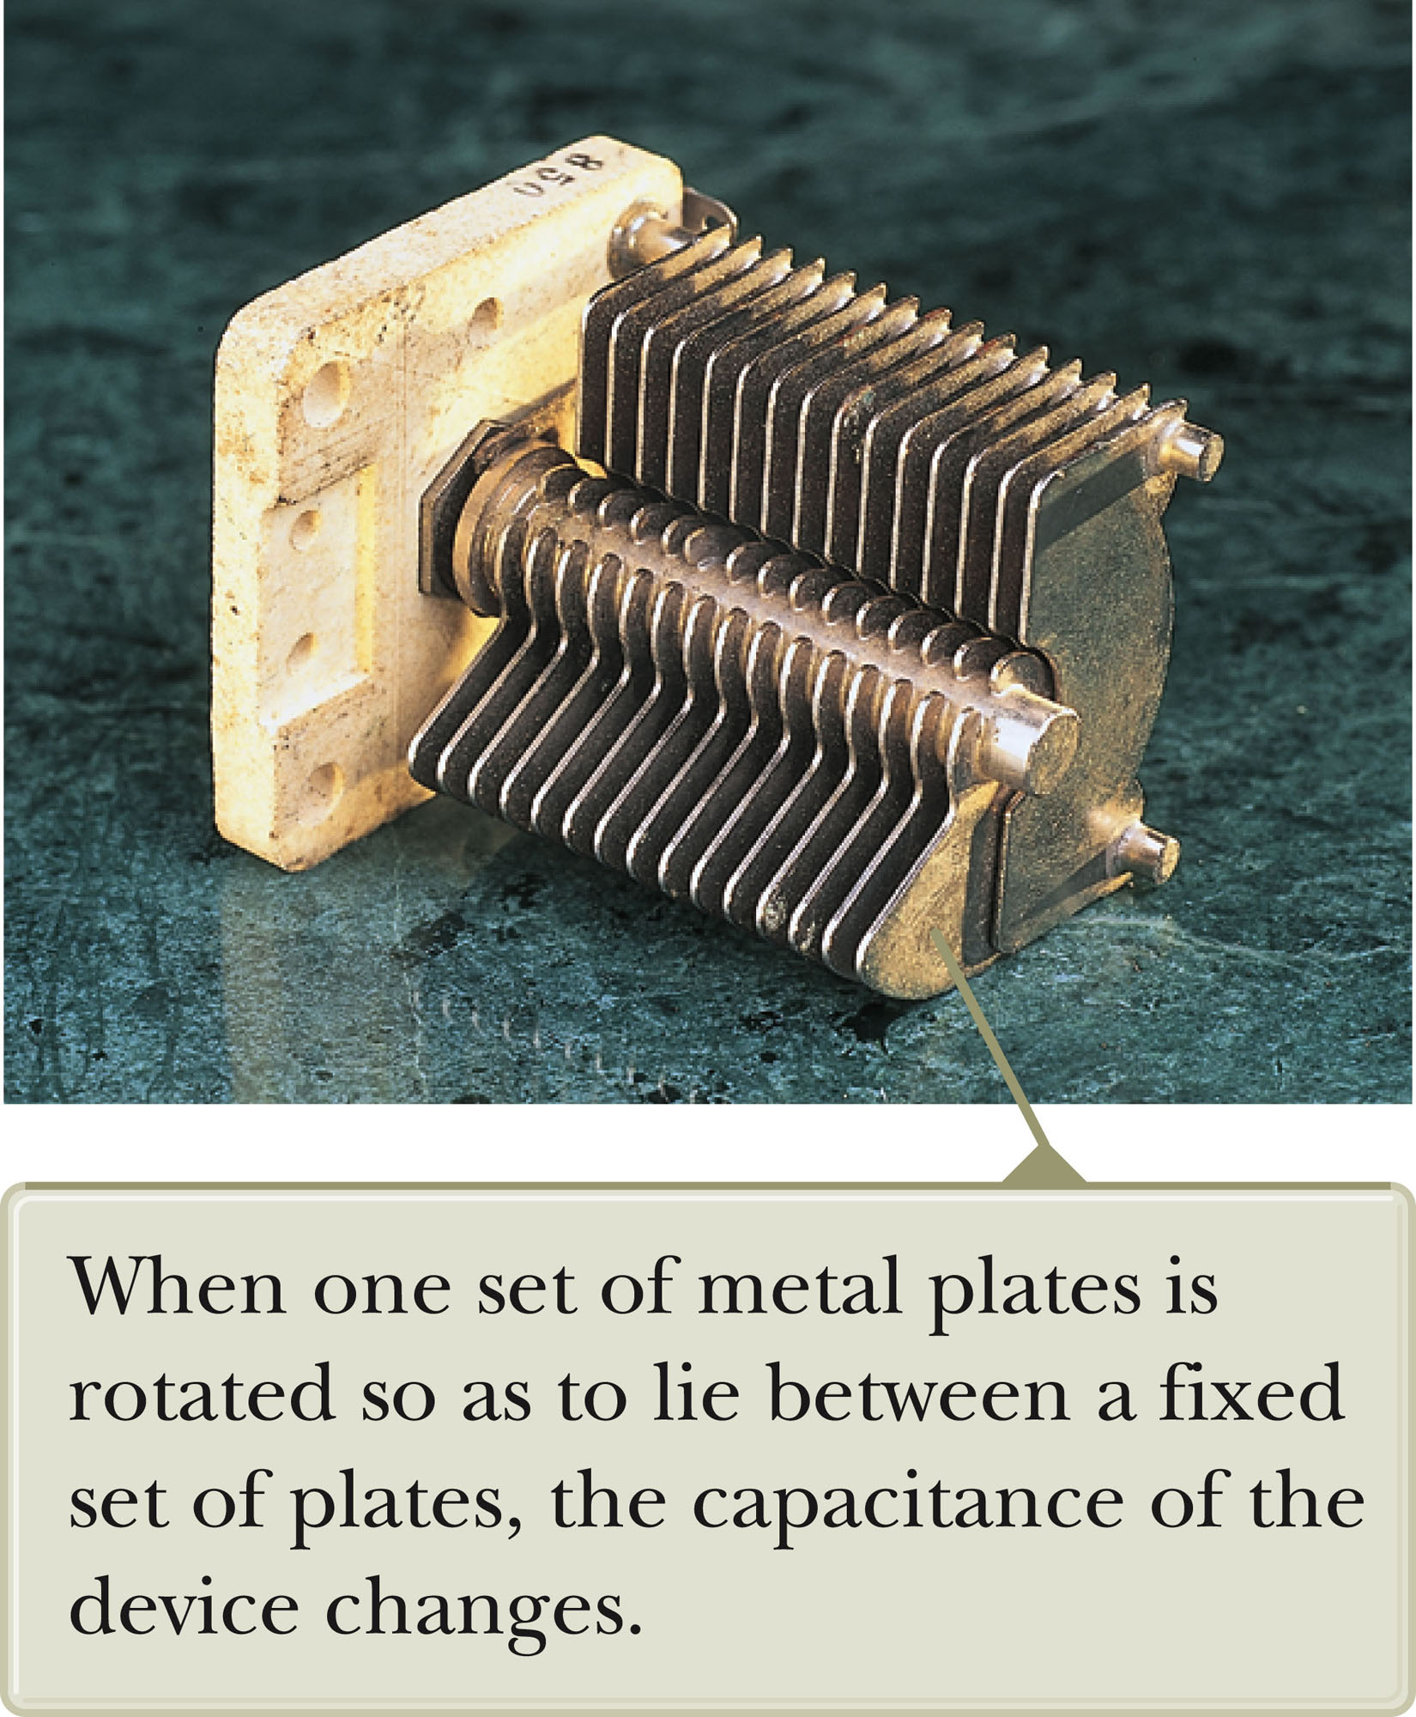
Types of Capacitors – Variable
Variable capacitors consist of two interwoven sets of metallic plates.
One plate is fixed and the other is movable.
Contain air as the dielectric
These capacitors generally vary between 10 and 500 pF.
Used in radio tuning circuits
Section 26.5

Slide 34
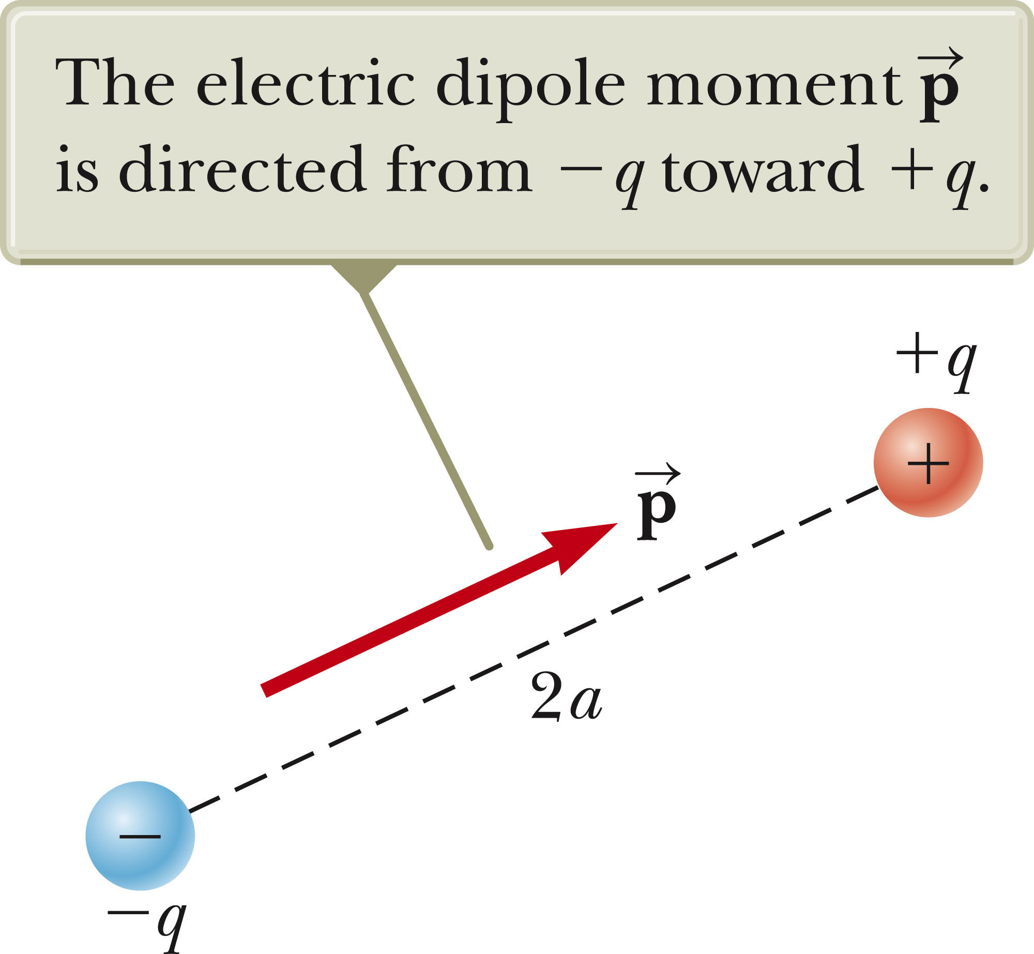
Electric Dipole
An electric dipole consists of two charges of equal magnitude and opposite signs.
The charges are separated by 2a.
The electric dipole moment ( ) is directed along the line joining the charges from –q to +q.
Section 26.6

Slide 35
Electric Dipole, 2
The electric dipole moment has a magnitude of p ≡ 2aq.
Assume the dipole is placed in a uniform external field,
  is external to the dipole; it is not the field produced by the dipole
Assume the dipole makes an angle θ with the field
Section 26.6

Slide 36
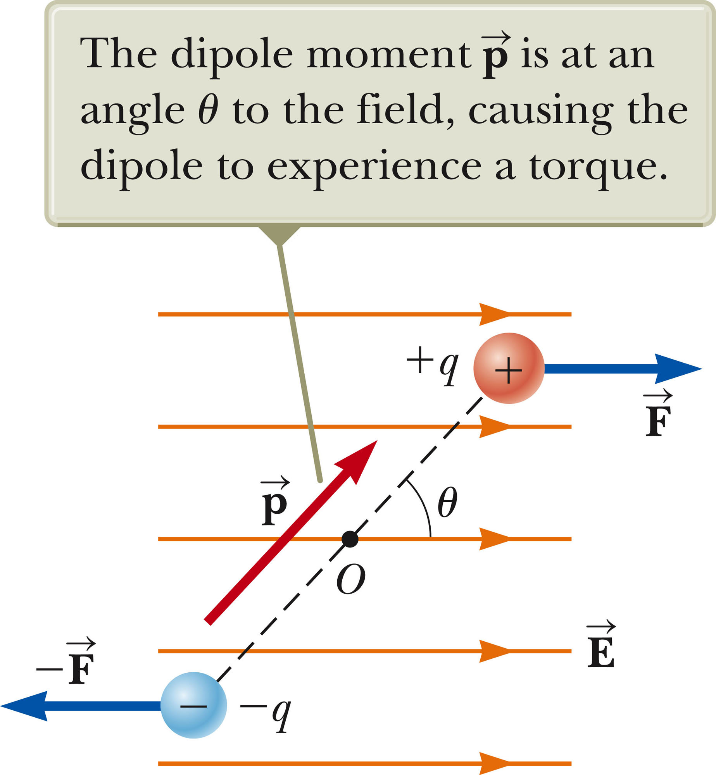
Electric Dipole, 3
Each charge has a force of F = Eq acting on it.
The net force on the dipole is zero.
The forces produce a net torque on the dipole.
The dipole is a rigid object under a net torque.
Section 26.6

Slide 37
Electric Dipole, final
The magnitude of the torque is:
τ = 2Fa sin θ = pE sin θ
The torque can also be expressed as the cross product of the moment and the field:

The system of the dipole and the external electric field can be modeled as an isolated system for energy.
The potential energy can be expressed as a function of the orientation of the dipole with the field:
U_{f} – U_{i} = pE(cos θ_{i} – cos θ_{f}) → U = - pE cos θ
This expression can be written as a dot product.
Section 26.6

Slide 38
Polar vs. Nonpolar Molecules
Molecules are said to be polarized when a separation exists between the average position of the negative charges and the average position of the positive charges.
Polar molecules are those in which this condition is always present.
Molecules without a permanent polarization are called nonpolar molecules.
Section 26.6

Slide 39
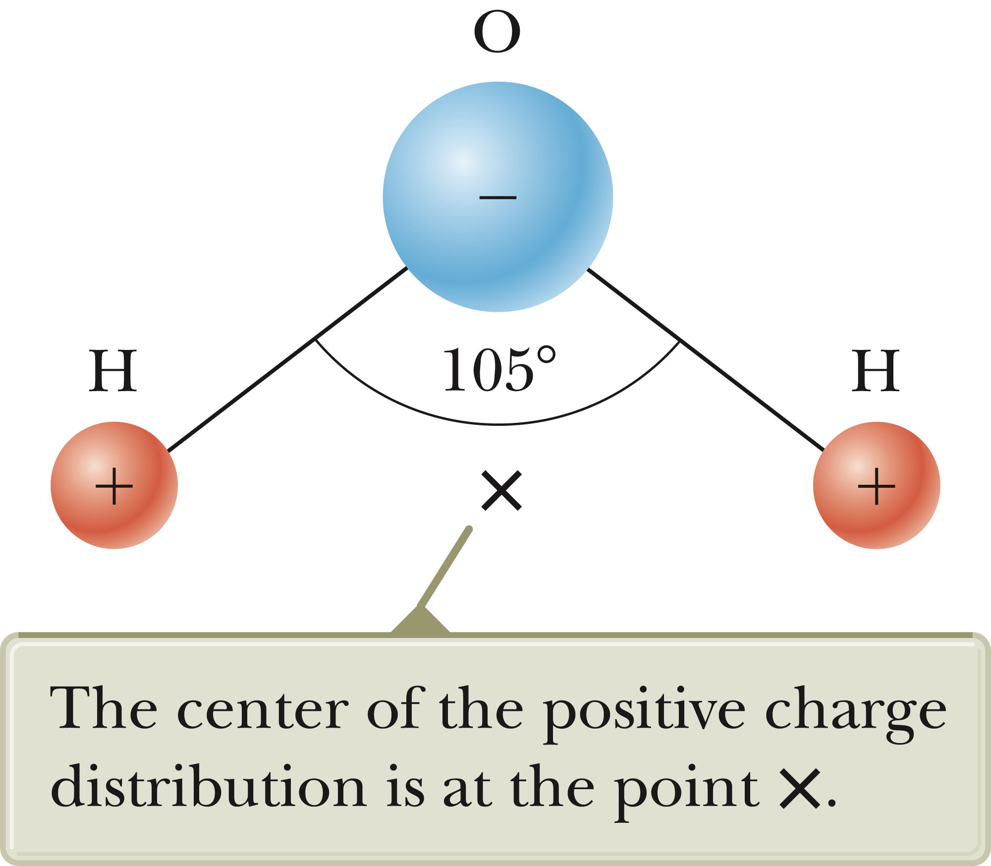
Water Molecules
A water molecule is an example of a polar molecule.
The center of the negative charge is near the center of the oxygen atom.
The x is the center of the positive charge distribution.
Section 26.6

Slide 40
Polar Molecules and Dipoles
The average positions of the positive and negative charges act as point charges.
Therefore, polar molecules can be modeled as electric dipoles.
Section 26.6

Slide 41
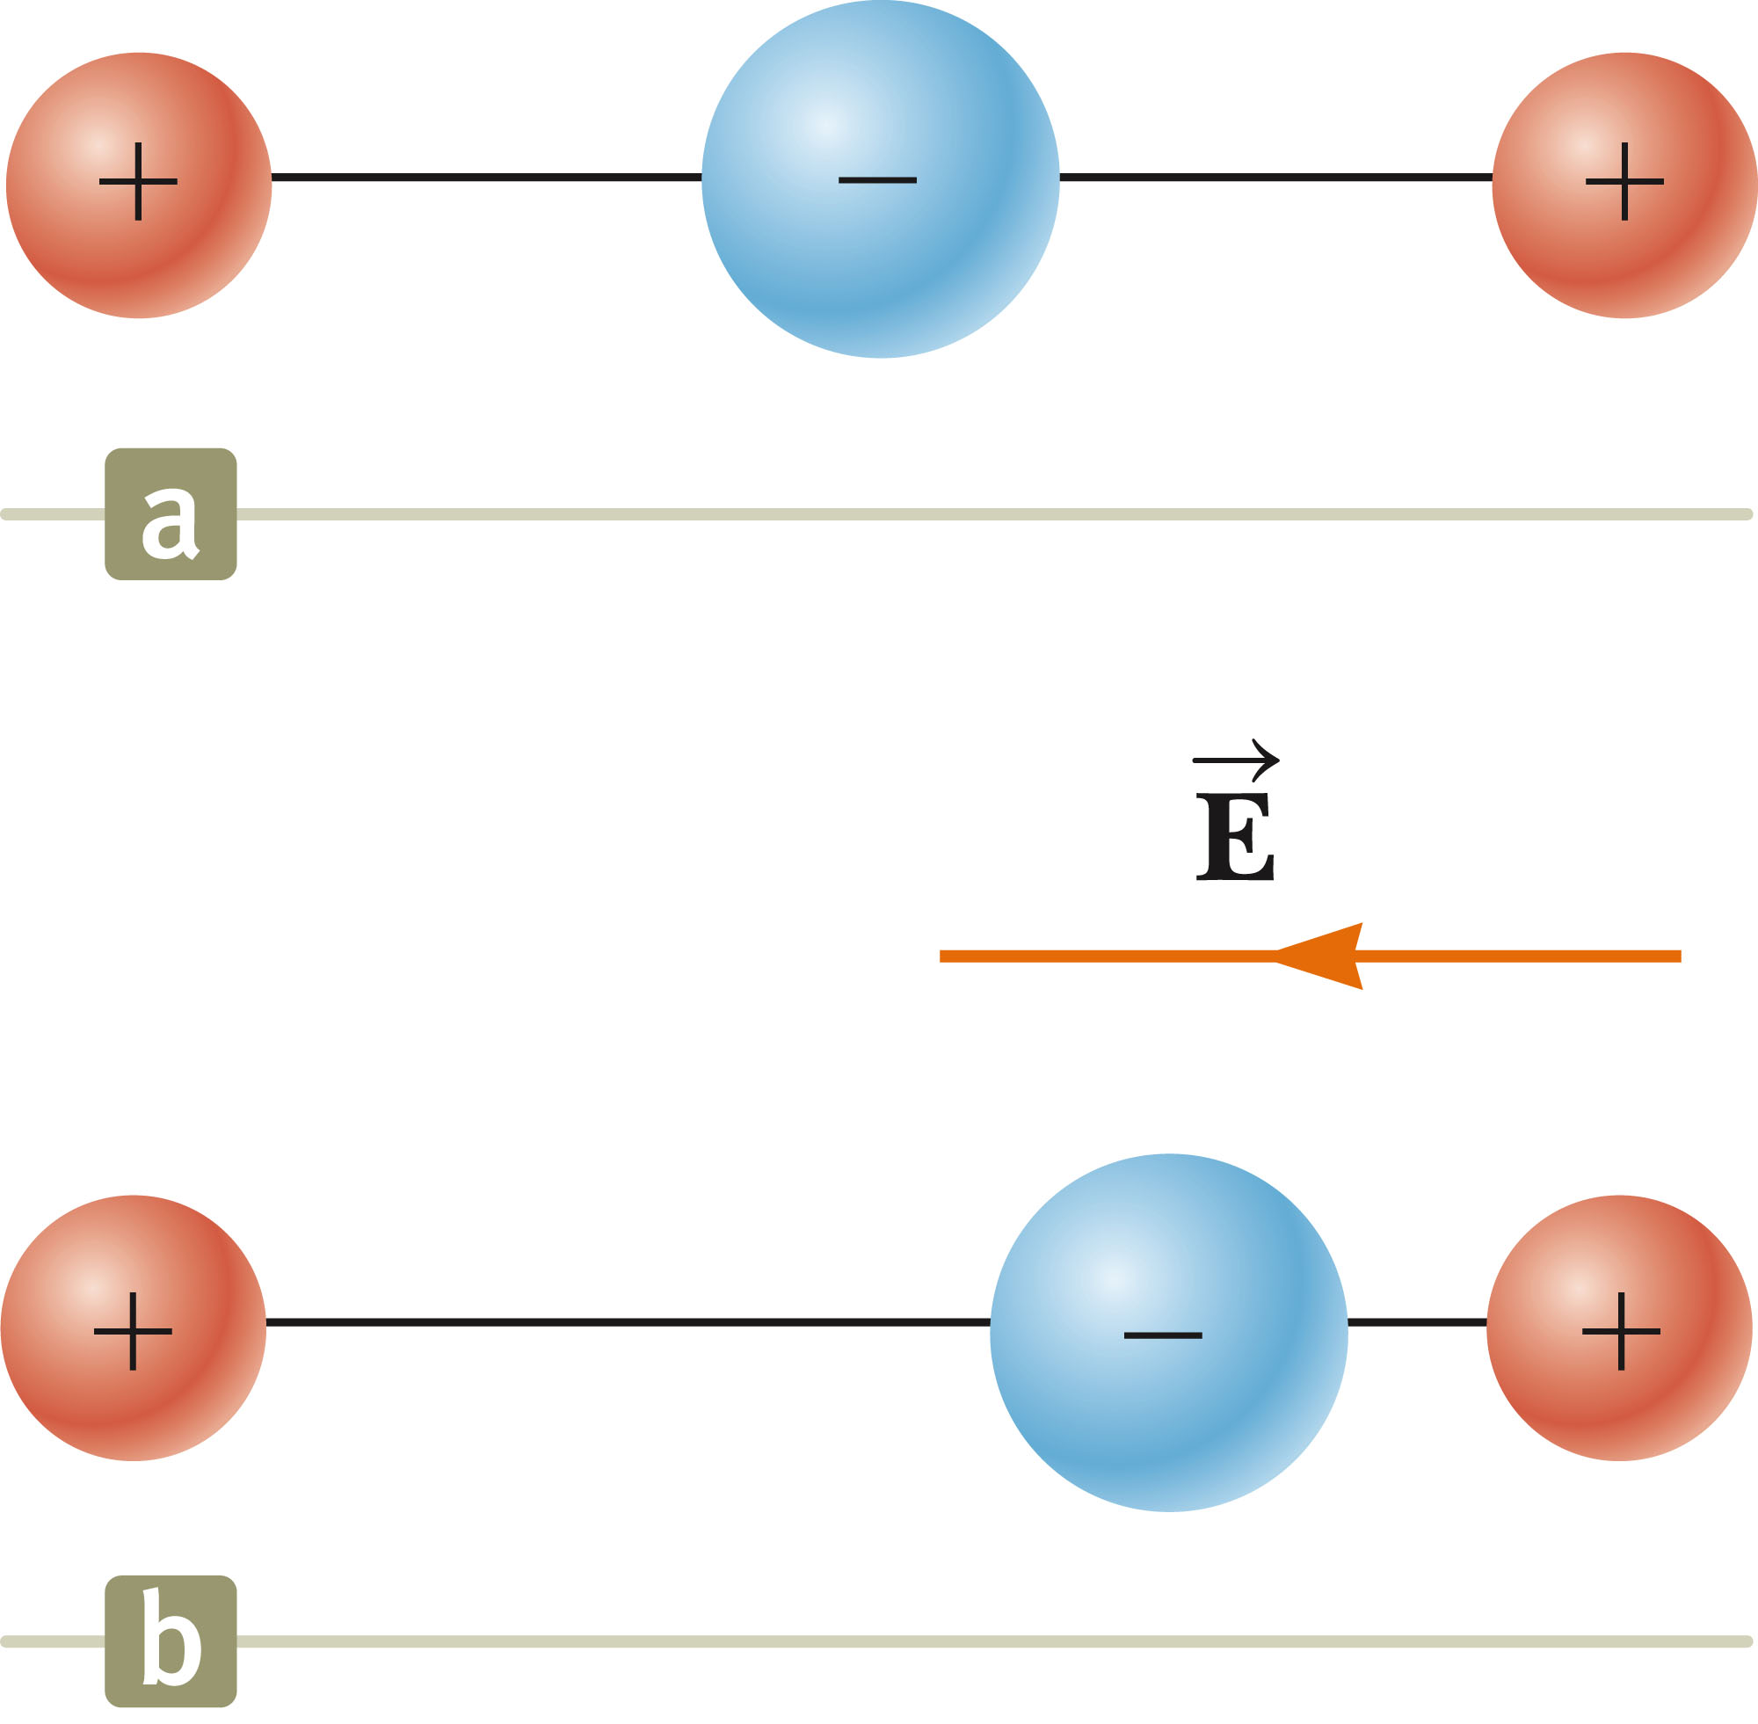
Induced Polarization
A linear symmetric molecule has no permanent polarization (a).
Polarization can be induced by placing the molecule in an electric field (b).
Induced polarization is the effect that predominates in most materials used as dielectrics in capacitors.
Section 26.6

Slide 42
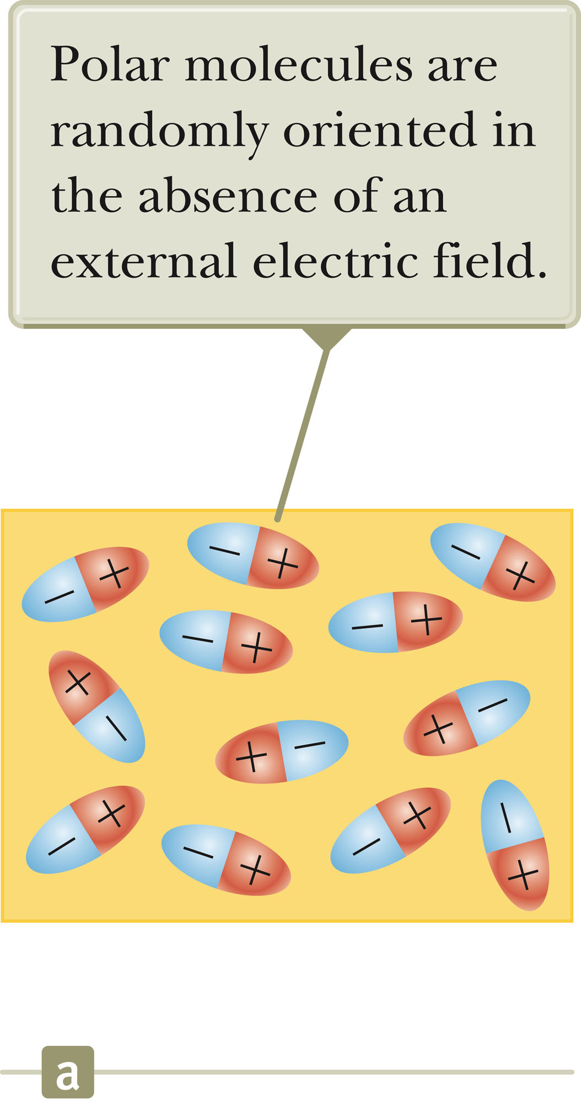
Dielectrics – An Atomic View
The molecules that make up the dielectric are modeled as dipoles.
The molecules are randomly oriented in the absence of an electric field.
Section 26.7

Slide 43
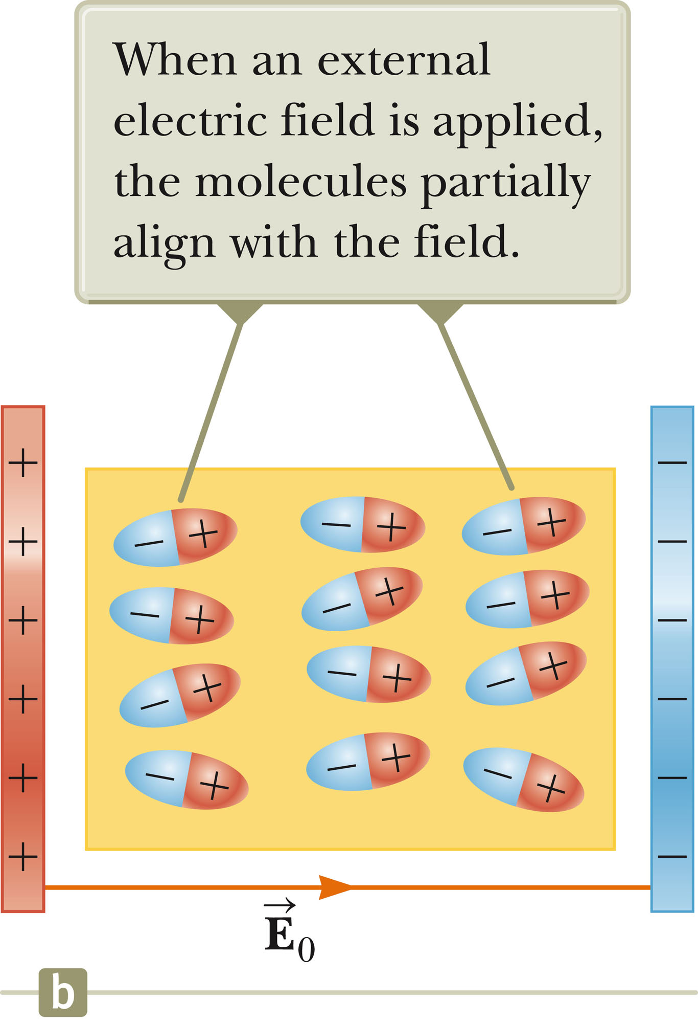
Dielectrics – An Atomic View, 2
An external electric field is applied.
This produces a torque on the molecules.
The molecules partially align with the electric field.
  The degree of alignment depends on temperature and the magnitude of the field.
    In general, the alignment increases with decreasing temperature and with increasing electric field.
Section 26.7

Slide 44
Dielectrics – An Atomic View, 4
If the molecules of the dielectric are nonpolar molecules, the electric field produces some charge separation.
This produces an induced dipole moment.
The effect is then the same as if the molecules were polar.
Section 26.7

Slide 45
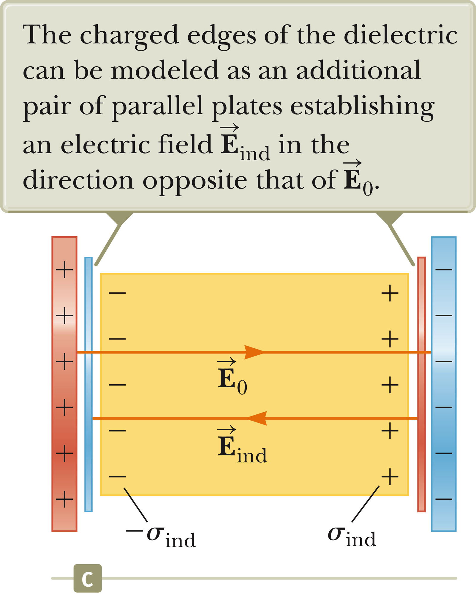
Dielectrics – An Atomic View, final
An external field can polarize the dielectric whether the molecules are polar or nonpolar.
The charged edges of the dielectric act as a second pair of plates producing an induced electric field in the direction opposite the original electric field.
Section 26.7

Slide 46
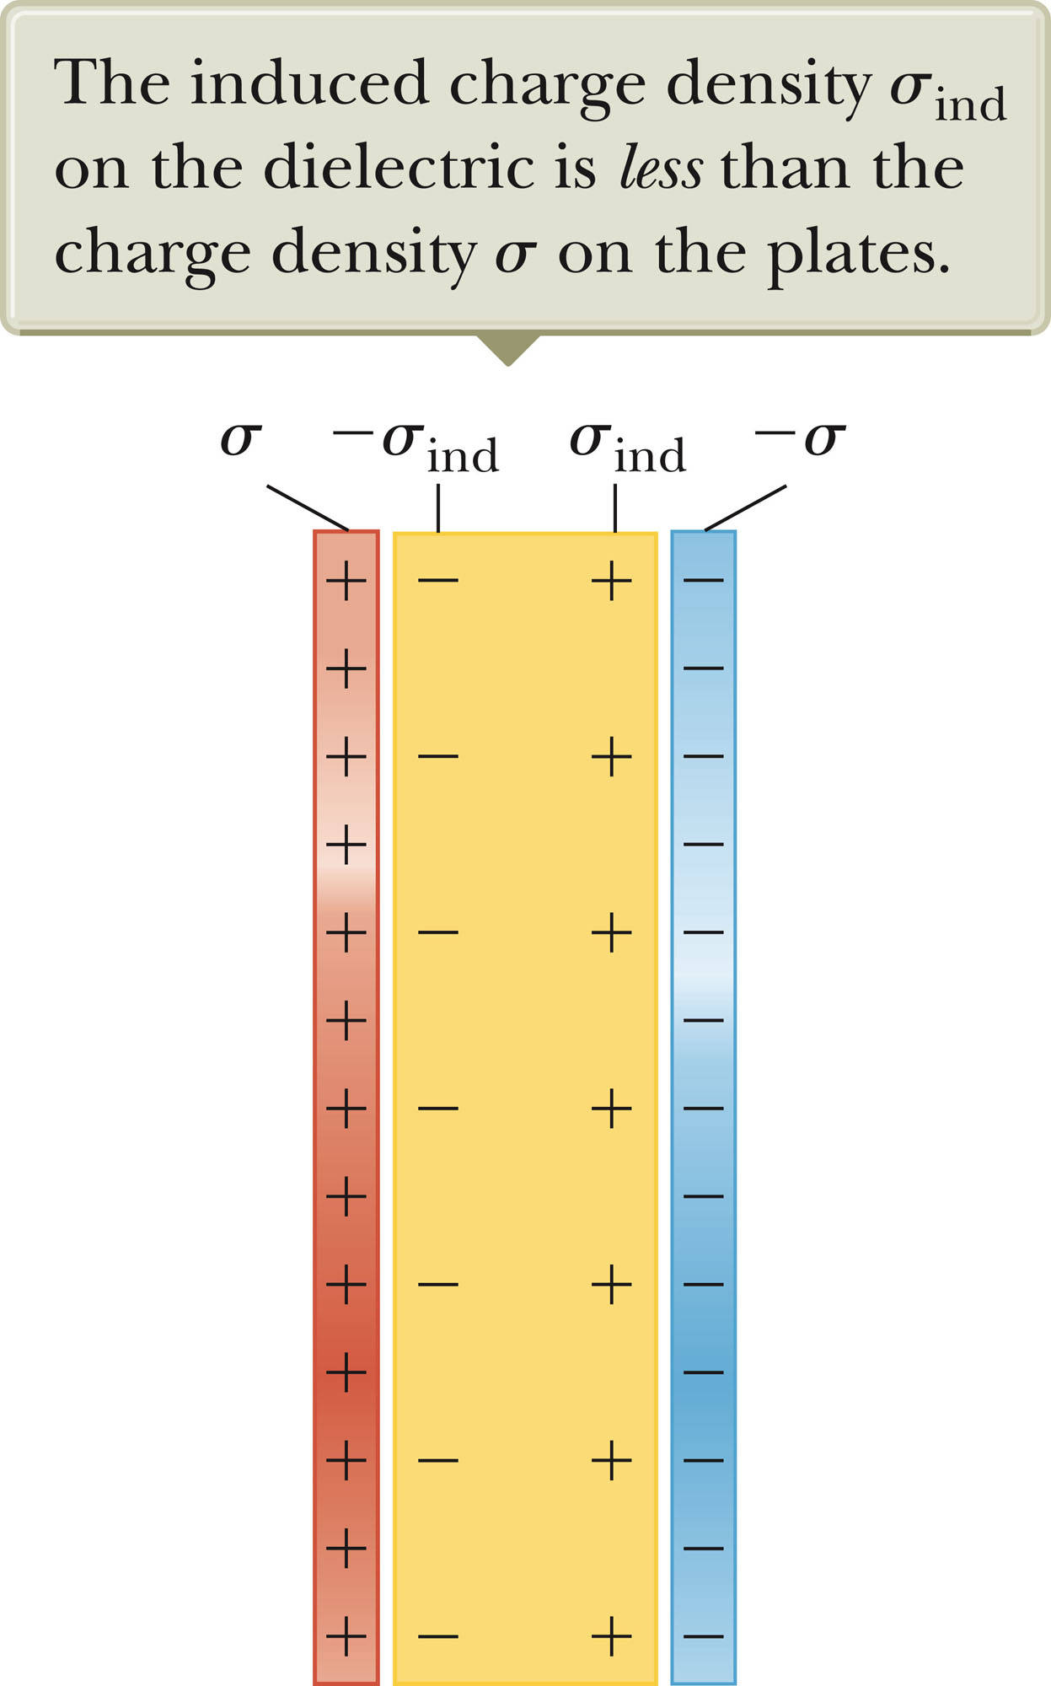
Induced Charge and Field
The electric field due to the plates is directed to the right and it polarizes the dielectric.
The net effect on the dielectric is an induced surface charge that results in an induced electric field.
If the dielectric were replaced with a conductor, the net field between the plates would be zero.
Section 26.7

